Slide 1
Rationale for the subjects in the curriculum
Day Two Session 2

Slide 2
SESSION OUTCOMES
To appreciate the rationale for each of the subjects
To appreciate the subject contribution to Key Learning Outcomes, Generic Skills, Values and Cross- Cutting Issues

Slide 3
INTRODUCTION
The curriculum menu has a number of subjects
Each of the subjects has a rationale as to why it was included on the curriculum menu.
A rationale is brief description of what a particular subject will provide to the learner who goes through that programme of study.

Slide 4
Activity 1(10 minutes)
In groups, discuss the significance of your subject in the revised curriculum.
Compare the discussion outcome with the rationale for the subject as stated in the syllabus document and come up with the relationship between the two.
Present in plenary

Slide 5
KEY POINTS
Each subject has a rationale on the curriculum menu
It is important to understand the rationale before you read the rest of the document.
Each of the subjects holds a special place in the curriculum because of the knowledge, understandings, skills, values and skills it provides to the learner.

Slide 6
Activity 2 (10 minutes)
Work in subject groups, discuss your subject contribution to the Key Learning Outcomes, Generic Skills, Values and Cross- Cutting Issues
Share in plenary

Slide 7
THANK YOU

Slide 8
FEATURES OF THE OF THE SYLLABUS DOCUMENT
Day Two Session 3

Slide 9
SESSION OUTCOMES
Understand what is meant by syllabus
Identify the key features of the syllabus document in specific subjects
Appreciate the importance of each of the features in the syllabus

Slide 10
INTRODUCTION
There are many curriculum documents that were developed to support the Lower Secondary Reform.
One of them and most important is the syllabus document.
Each subject area developed a specific syllabus to take care of the competencies and Learning outcomes
Each of the syllabuses takes care specific knowledge, understanding, skills, values and attitudes to be acquired in the specific.
A syllabus therefore is a document for teaching in that it serves to outline the basic elements of the program of learning and teaching including what themes and topics to be covered in a specific learning cycle

Slide 11
Features of the Syllabus document
The syllabus document has two divisions
The Preliminary information
The detailed syllabus

Slide 12
PRELIMINARY INFORMATION
It is a common practice by many readers not to read the preliminaries for different documents.
This information is important because it prepares the reader for what is in the main document.

Slide 13
Activity 1 (15minutes)
In groups, use the preliminary information in different subjects to:
Discuss features of the curriculum that appear in this section.
State the importance of each of the features to the teacher and the learning process.
Share in plenary

Slide 14
KEY POINTS
The preliminary information includes:
The foreword, acknowledgement, aims of education, background to the curriculum, key learning outcomes, generic skills, cross-cutting issues, ICT integration, time allocation, rationale and the programme planner chart.
Each one of them has a special message to convey to the reader which is linked to the main syllabus document.
It is important to read and internalize them for better understanding of the document and support the learners.

Slide 15
Activity 2 (15 minutes)
Using the sample of the detailed syllabus provided:
Identify the key features of the detailed syllabus
Discuss the importance of each one of the features
Share in plenary

Slide 16
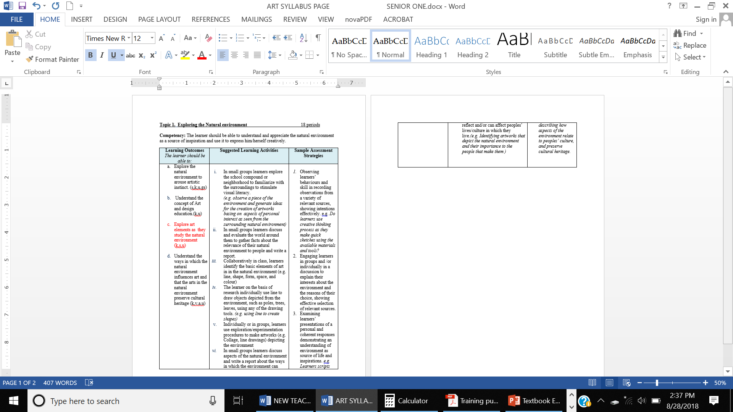
The detailed syllabus for Activity3 above

Slide 17
KEY POINTS
The detailed syllabus has the following features
Theme
Topic
Number of periods
Competency
Learning outcomes
Suggested learning activities
Sample assessment strategies

Slide 18
THANK YOU

